Slide 1
Introduction
191005 Thant Min Htet
This is a website that introduce Popular cultures in Japan (Japanese Pop cultures.)
This website is design for entertainment.
Mainly target to the young users and people who want to entertain themselves by learning about Japanese Popular cultures.
Main web technology used in this website were, HTML, CSS, JS and Framework and libraries such as React.js, Router, Hooks, frontawesome etc.
# Production Planning and Web technology usage was mainly push effort in this first assignment.

Slide 2
Production Report
Introduce culture, Entertainment Website/ Responsive layout/ Fun and Playful/ Gradient Color theme, Fluid Page transitions.
User flow,
Site map, Wireframes
Web site Development(JSX/CSS/JS, React.js)
Planning, Idea storming and Research
Contents Preparations
Finished Product and Deployment on Heroku
Testing Web Technology to create website
Implement images, icons and page transitions

Slide 3
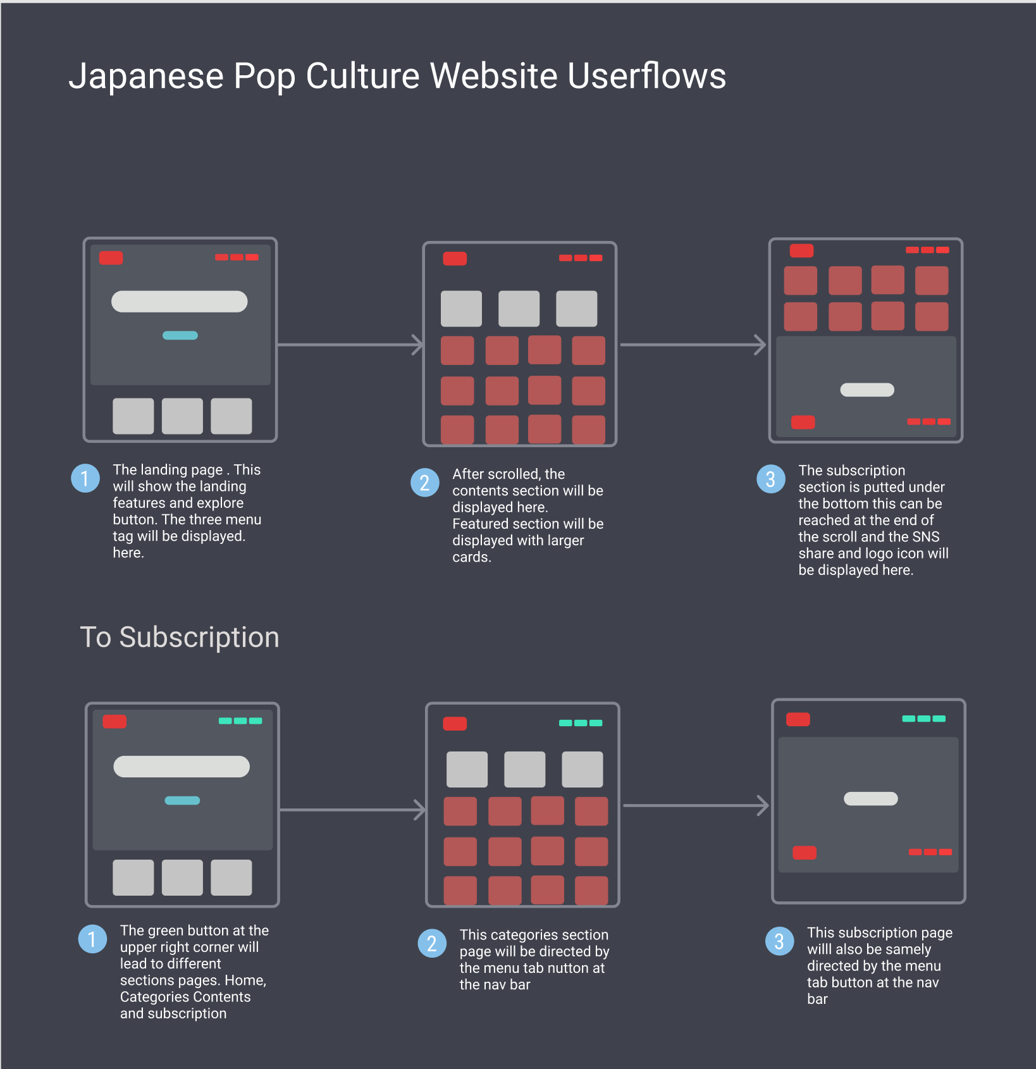
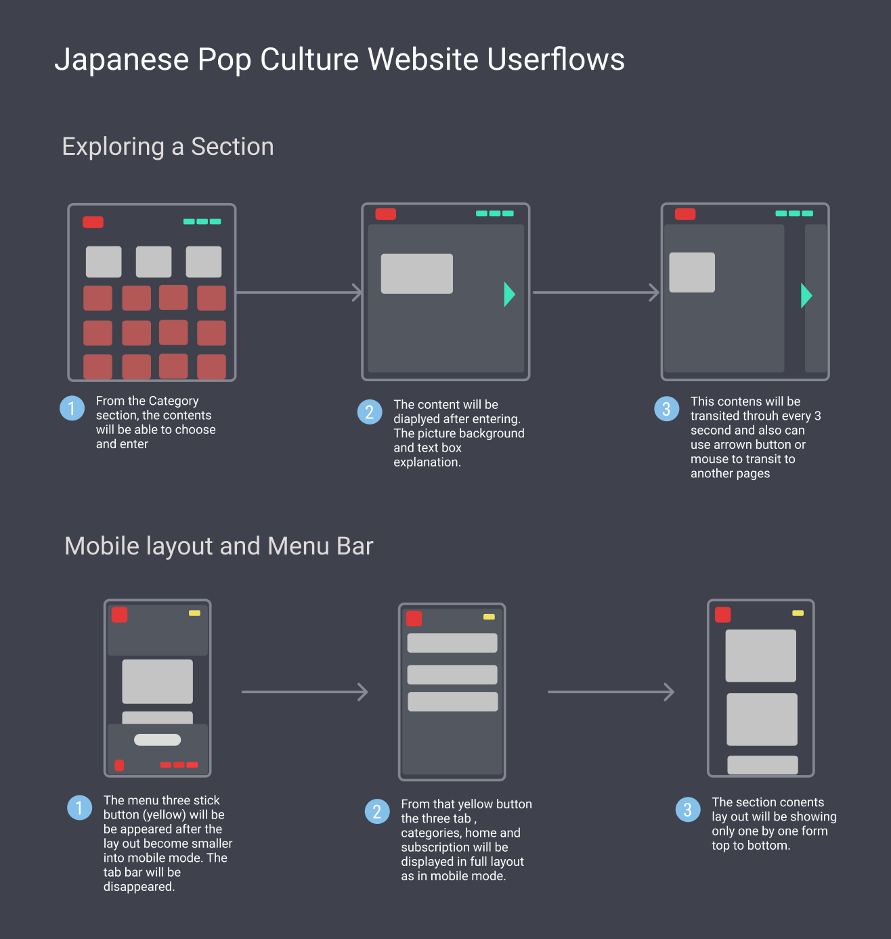
Concepts, User flow and Site maps

Slide 4
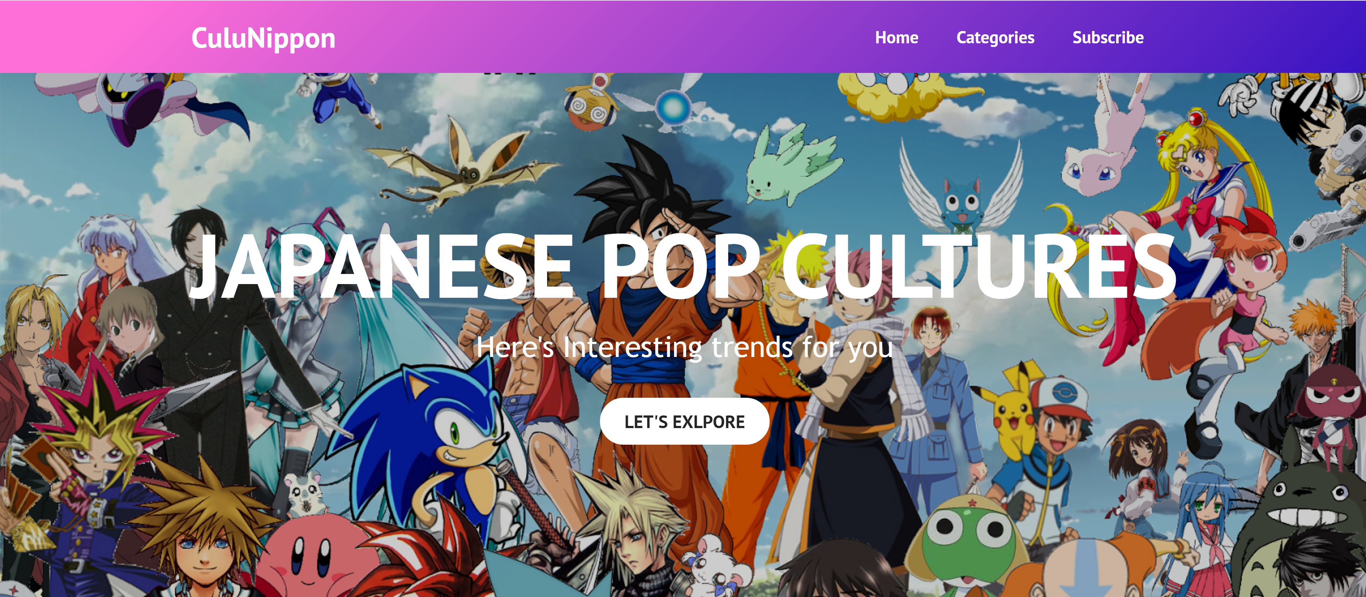
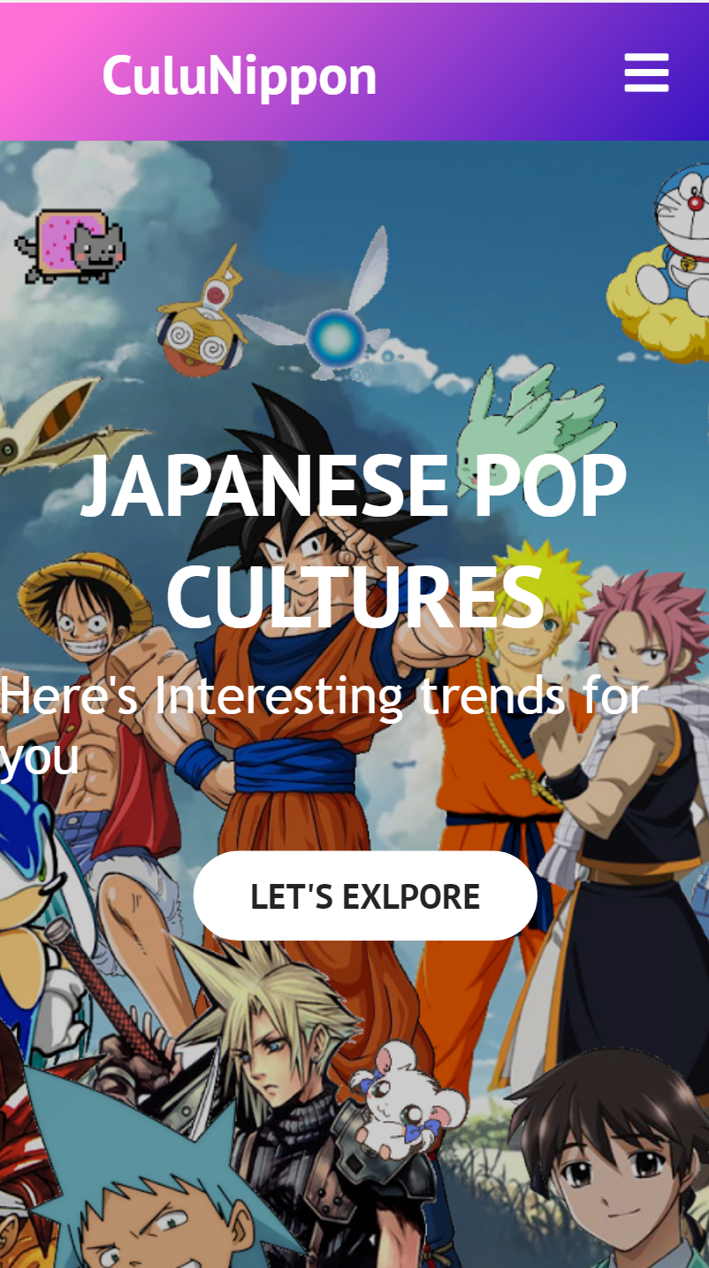
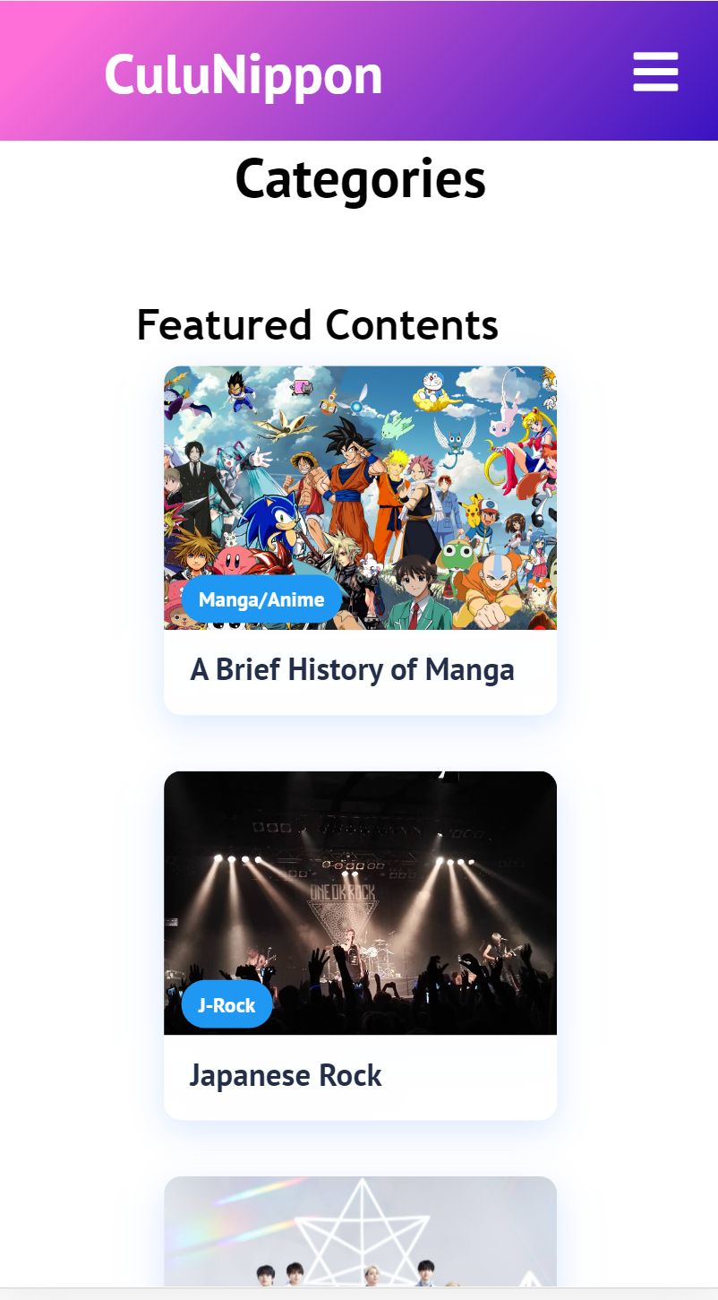
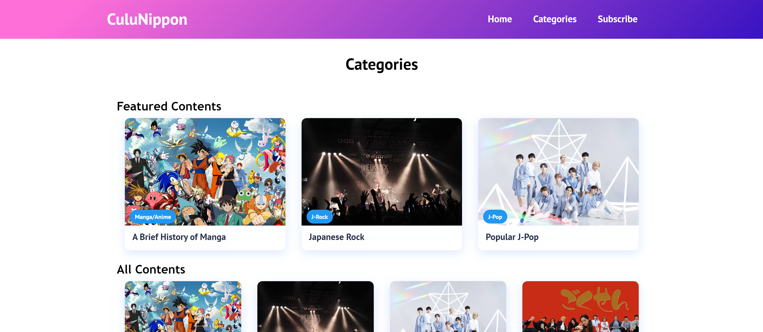
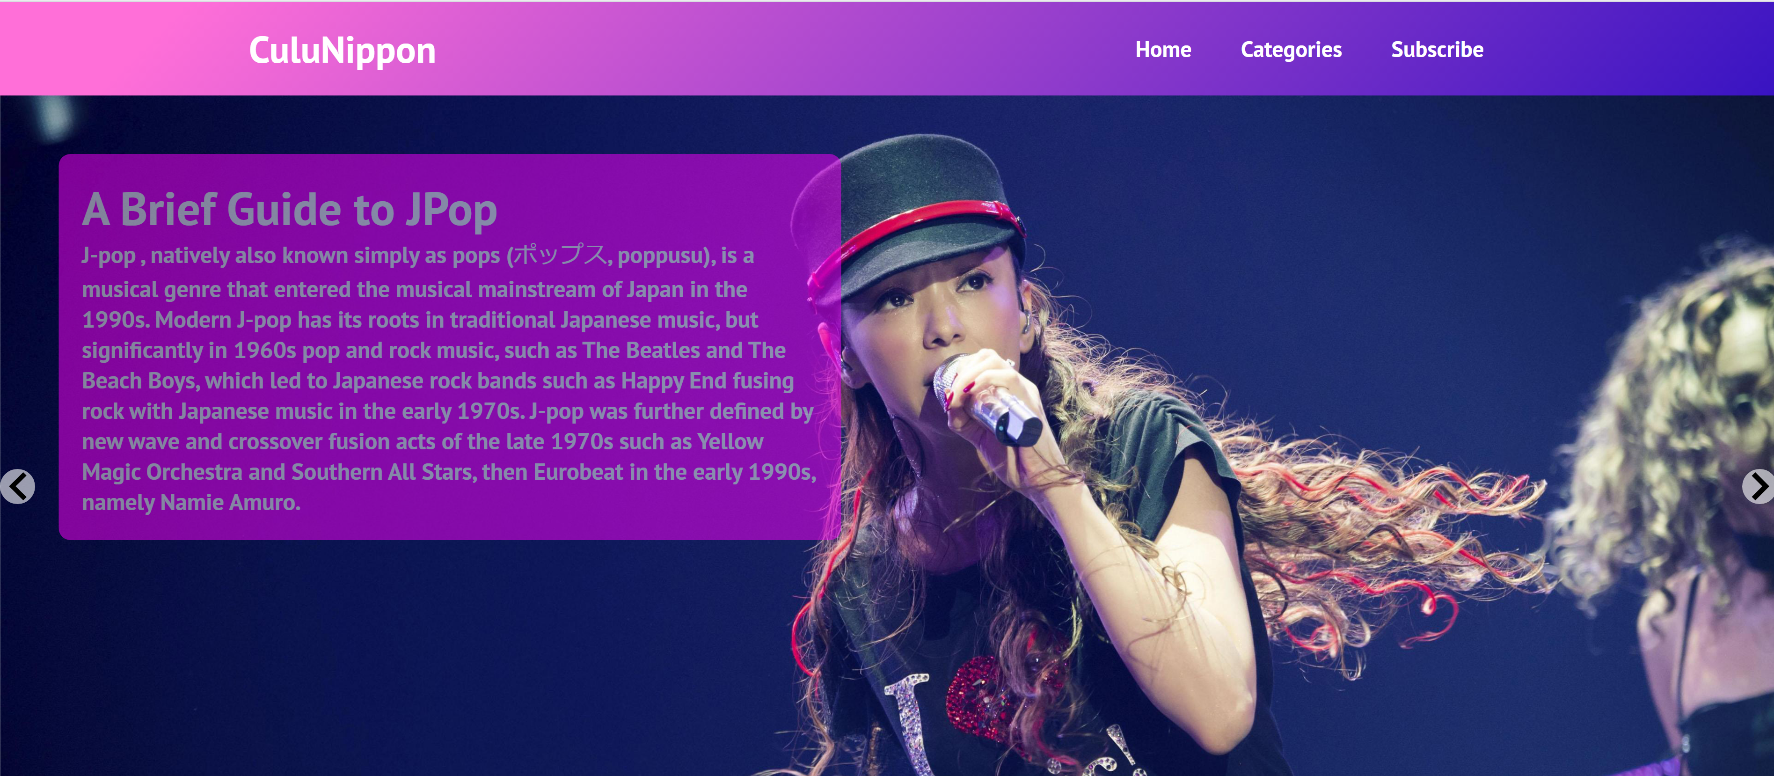
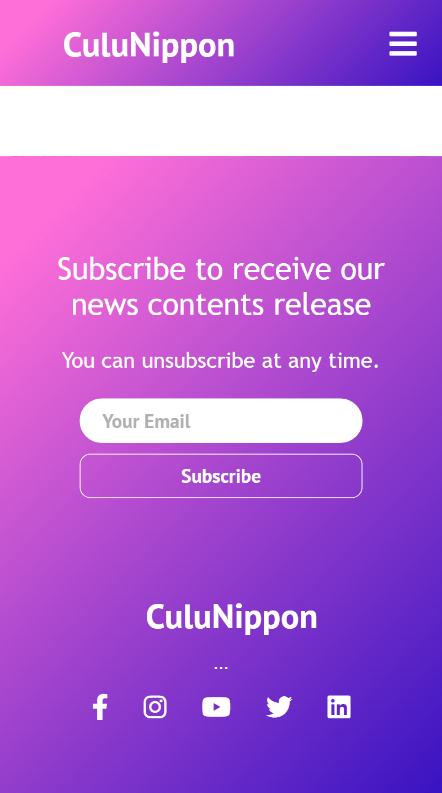

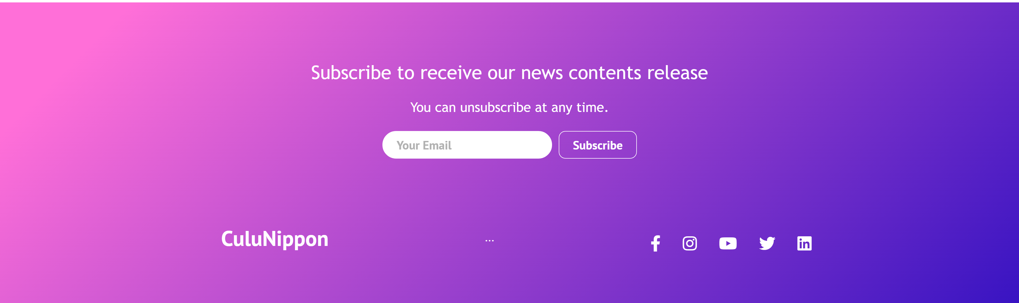
PC screen Mode
Mobile Screen Mode

Slide 5
Deployment on Heroku
Please check the website deployed on Heroku from the link here,
https://culujp-pop-culutre.herokuapp.com/
(This deployment is just temporary in order to be easier checking the assignment without installing dependencies in the local machine. This link will not be published )

Slide 6
References
Images (Unsplash, Wikipedia)
Icons ( Font Awesome)
Code (Stack overflow, React official documentation Page)
Contents: (Japan times, Wikipedia)
https://www.japantimes.co.jp/culture
https://www.sonymusic.co.jp/artist
https://www.wallpapercave.com
https://www.wikipedia.co.jp
https://fontawesome.com/how-to-use/on-the-web/using-with/react
https://stackoverflow.com/questions/33188994/scroll-to-the-top-of-the-page-after-render-in-react-js
# Images were taken from the above reference sites. # The icon and logo are free to use.
# Contents Card Design was inspired from the UI layout of Dribble website and partially referenced.
# The rest of the materials, designs in development process were own creation.

